Slide 1
Cloud Computing Mechanisms Cloud Infrastructure Mechanisms
UNIT 2

Slide 2
Cloud Computing Mechanisms
Mechanism refers to techniques that are used to solve something
Cloud Computing mechanism all such techniques that is used to enable cloud computing

Slide 3
CLOUD COMPUTING MECHANISMS CATEGORIES
CLOUD COMPUTING MECHANISMS
CLOUD INFRASTRUCTURE MECHANISMS
SPECIALIZED CLOUD MECHANISMS
CLOUD MANAGEMENT MECHANISMS
CLOUD SECURITY MECHANISMS

Slide 4
CLOUD COMPUTING MECHANISMS
CLOUD COMPUTING MECHANISMS CATEGORIES
implement lower level virtual infrastructure components like Virtual Machines, Networks, Storage etc.
CLOUD INFRASTRUCTURE MECHANISMS
ensure cloud is always running as per the expected and desired cloud characteristics
eg. load balancing, SLA monitoring, hypervisor etc.
SPECIALIZED CLOUD MECHANISMS
software to help coordinate the resources as per the management actions from users such as cloud consumers
eg VIM, Billing software etc.
CLOUD MANAGEMENT MECHANISMS
CLOUD SECURITY MECHANISMS
Security techniques to keep the cloud secure

Slide 5
CLOUD COMPUTING MECHANISMS
CLOUD INFRASTRUCTURE MECHANISMS
CLOUD MANAGEMENT MECHANISMS
Logical Network Perimeter
Virtual Server
Cloud Storage Device
Cloud Usage Monitor
Resource Replication
Ready-Made Environment
Remote Administration System
Resource Management System
SLA Management System
Billing Management System
SPECIALIZED CLOUD MECHANISMS
CLOUD SECURITY MECHANISMS
Automated Scaling Listener
Load Balancer
SLA Monitor
Pay-Per-Use Monitor
Audit Monitor
Failover System
Hypervisor
Resource Cluster
Multi-Device Broker
State Management Database
Encryption
Hashing
Digital Signature
Public Key Infrastructure
Identity and Access Management
Single Sign-on
Cloud Security Groups
Hardened Virtual Server Images

Slide 6
Note that each mechanism is supporting the underlying mechanism
Except that Cloud Security Mechanism is used in all other types of cloud computing mechanisms
cloud consumer
cloud provider
CLOUD MANAGEMENT MECHANISMS
SPECIALIZED CLOUD MECHANISMS
CLOUD SECURITY MECHANISMS
CLOUD INFRASTRUCTURE MECHANISMS
CLOUD COMPUTING MECHANISMS

Slide 7
In this presentation we will look at one particular type of cloud computing mechanism namely
CLOUD INFRASTRUCTURE MECHANISM

Slide 8
CLOUD INFRASTRUCTURE MECHANISMS
Cloud infrastructure mechanisms are
foundational building blocks of cloud environments
that establish primary artifacts to form the
basis of fundamental cloud technology architecture
Cloud infrastructure mechanisms are
infrastructure core components
that are common to cloud platforms

Slide 9
CLOUD INFRASTRUCTURE MECHANISMS
There are six cloud infrastructure core components/mechanisms that are common to cloud platform
Logical Network Perimeter
Virtual Server
Cloud Storage Device
Cloud Usage Monitor
Resource Replication
Ready-Made Environment

Slide 10
CLOUD INFRASTRUCTURE MECHANISMS
Logical Network Perimeter
Virtual Server
Cloud Storage Device
Cloud Usage Monitor
Resource Replication
Ready-Made Environment
Techniques to implement networks in cloud
Techniques to implement machines in cloud
Techniques to implement storage in cloud
Techniques to monitor usage data of cloud resource
Techniques to replicate/duplicate resources such as networks, machines, software’s etc.
Techniques to provide a ready made platform solution to do something

Slide 11
1. LOGICAL NETWORK PERIMETER
CLOUD INFRASTRUCTURE MECHANISMS
Logical network perimeter is
isolation of a network environment
from the rest of a communications network
Logical Network Perimeter establishes
a virtual network boundary
that can encompass and isolate
a group of related cloud-based IT resources
that may be physically distributed

Slide 12
1. LOGICAL NETWORK PERIMETER
CLOUD INFRASTRUCTURE MECHANISMS
Why implement logical network perimeter ?
The logical network perimeter mechanism can be implemented to:
isolate IT resources in a cloud from non-authorized users
isolate IT resources in a cloud from non-users
isolate IT resources in a cloud from cloud consumers
control the bandwidth that is available to isolated IT resources

Slide 13
1. LOGICAL NETWORK PERIMETER
CLOUD INFRASTRUCTURE MECHANISMS
How is logical network perimeter implemented ?
Logical network perimeters are typically
established via network devices
that supply and control the connectivity of a data center
and are commonly deployed as virtualized IT environments that include:
Virtual Firewall
Virtual Network

Slide 14
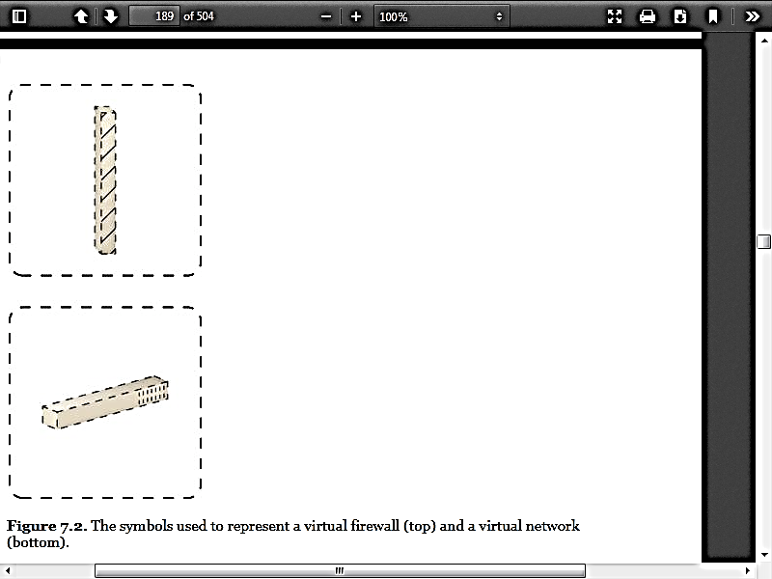
1. LOGICAL NETWORK PERIMETER
CLOUD INFRASTRUCTURE MECHANISMS
Symbols used in logical network perimeter
Virtual Firewall
Virtual Network

Slide 15
1. LOGICAL NETWORK PERIMETER
CLOUD INFRASTRUCTURE MECHANISMS
Logical network perimeter cloud resources
Virtual Firewall
An IT resource that actively filters network traffic to and from the isolated network such as a virtual network while controlling its interactions with the Internet
Virtual Network
Usually acquired through VLANs, this IT resource isolates the network environment within the data center infrastructure.

Slide 16
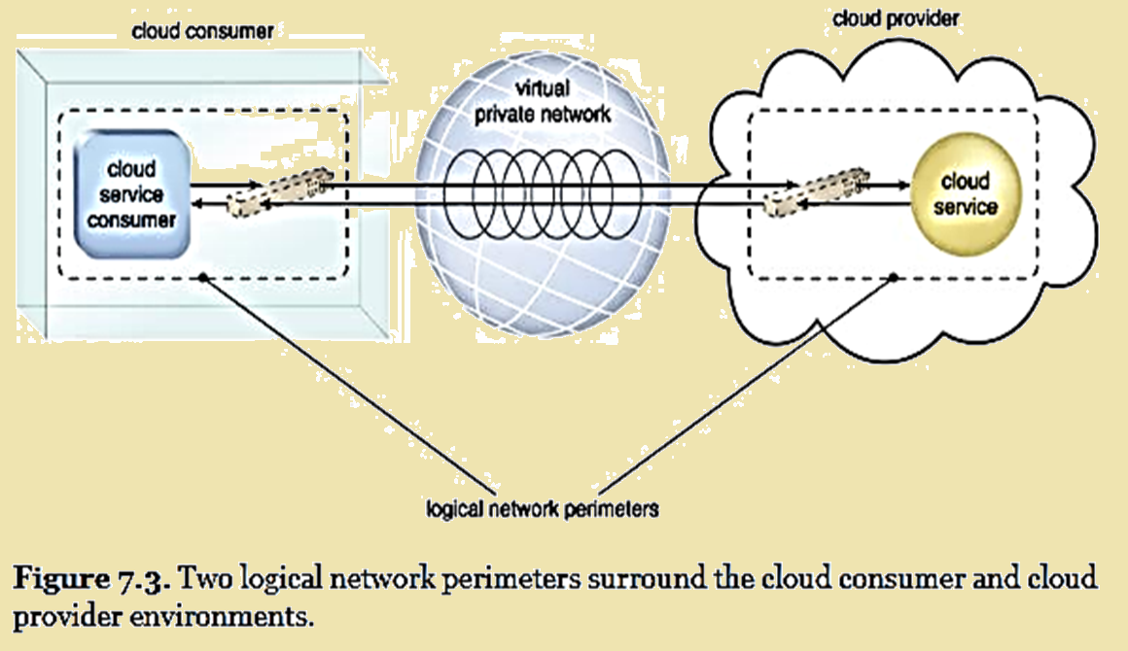
1. LOGICAL NETWORK PERIMETER
CLOUD INFRASTRUCTURE MECHANISMS

Slide 17
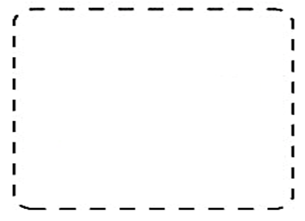
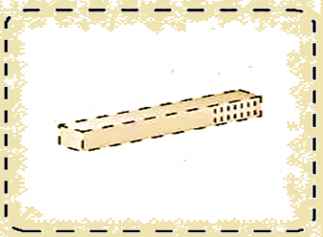
1. LOGICAL NETWORK PERIMETER
CLOUD INFRASTRUCTURE MECHANISMS
Cloud consumer
Cloud services
VLAN
VLAN (virtual network) does network segmentation to keep cloud consumer in a different network whereas cloud services in a different network

Slide 18
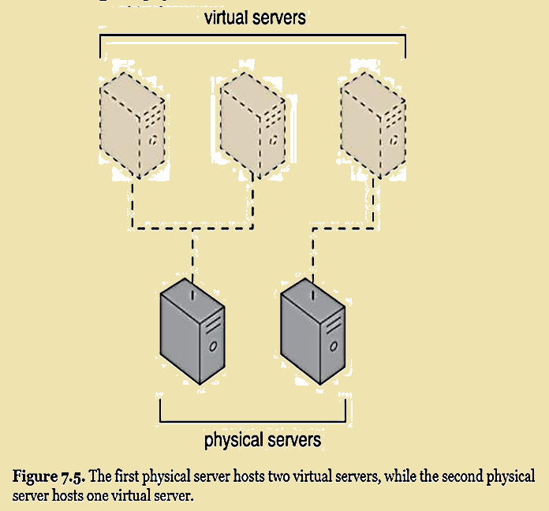
2. VIRTUAL SERVER
CLOUD INFRASTRUCTURE MECHANISMS
A VIRTUAL SERVER is a virtualization software that emulates a physical server
Virtual servers are used by cloud providers to share the same physical server with multiple cloud consumers by providing cloud consumers with individual virtual server instances
Virtual Server is also referred to as Virtual Machine or Virtual instance

Slide 19
2. VIRTUAL SERVER
CLOUD INFRASTRUCTURE MECHANISMS
As a commodity mechanism, the virtual server represents the most foundational building block of cloud environments
Virtual server (an IT resource) can be used to host
numerous IT resources (eg. CPU, storage, memory)
cloud-based solutions (such as java platform)
cloud computing mechanisms (a service agent program that monitors the cloud)

Slide 20
2. VIRTUAL SERVER
CLOUD INFRASTRUCTURE MECHANISMS
Virtual servers are instantiated ( means created )from image files.
Such a resource allocation process technique can be completed rapidly and on-demand
There may be two different cloud consumers on the same physical server but each using a different virtual server instance
Cloud consumers that install or lease virtual servers can customize their environments independently from other cloud consumers that may be using virtual servers hosted by the same underlying physical server

Slide 21
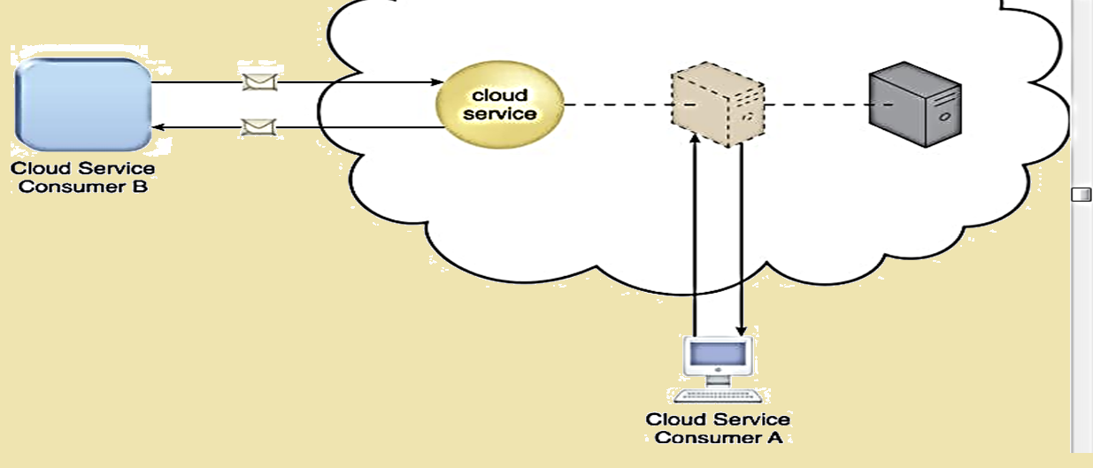
2. VIRTUAL SERVER
CLOUD INFRASTRUCTURE MECHANISMS
Permissions can be granted to multiple cloud consumer accounts to access a single virtual server
Figure 7.6 depicts a virtual server that hosts a cloud service
being accessed by Cloud Service Consumer B,
while Cloud Service Consumer A accesses the virtual server directly to perform an administration task

Slide 22
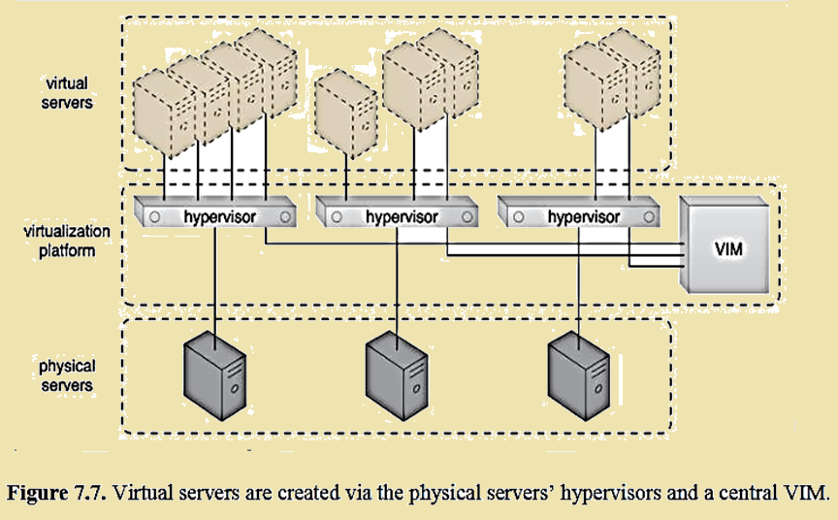
2. VIRTUAL SERVER
CLOUD INFRASTRUCTURE MECHANISMS
In the figure, we see Hypervisor software create and manage one of more virtual server software whereas Virtual Infrastructure Management (VIM) software manages one or more Hypervisors

Slide 23
3. CLOUD STORAGE DEVICE
CLOUD INFRASTRUCTURE MECHANISMS
The cloud storage device mechanism represents storage devices that are designed specifically for cloud-based provisioning
Instances of these storage devices can be virtualized, similar to how physical servers can spawn virtual server images.
Cloud storage devices are commonly able to provide fixed-increment capacity allocation in support of the pay-per-use mechanism
Cloud storage devices can be exposed for remote access via cloud storage services
Confidentiality, Security, Integrity, Legal and Regulatory requirements are important to on these storage as it contains cloud consumer’s data
Storages are WAN-based and not LAN-based and hence performance of large databases, network reliability and latency requirement has to be met too.
Cloud Storage Device mechanisms are accessible via cloud based API (also referred as storage interface

Slide 24
3. CLOUD STORAGE DEVICE
CLOUD INFRASTRUCTURE MECHANISMS
Cloud Storage Device mechanism provide common logical units of data storage, such as:
Files – Collections of data are grouped into files that are located in folders. Example in AWS, one can mount file system to store files
Blocks – The lowest level of storage and the closest to the hardware, a block is the smallest unit of data that is still individually accessible. In AWS the. Example, in AWS, one can allocate Elastic Block Storage for block data
Datasets –Sets of data are organized into a table-based, delimited, or record format. Example, in AWS, one can create Relational Database System to store data in table format
Objects –Data and its associated metadata are organized as Web-based resources. For example, in AWS, one can create Simple Storage Service (S3) objects which can be directly accessed via a web url

Slide 25
4. CLOUD USAGE MONITOR
CLOUD INFRASTRUCTURE MECHANISMS
The cloud usage monitor mechanism is a lightweight and autonomous software program responsible for collecting and processing IT resource usage data
The IT resource such as virtual server status (CPU, memory, storage), networks (bandwidth, latency, throughput) are examples of usage data that needs to be collected and processed by cloud usage monitor
The monitor collects these data and stores it in a separate log-database for post-processing and reporting purposes
There are three common agent-based implementation formats of cloud usage monitor
Monitoring Agent
Resource Agent
Polling Agent

Slide 26
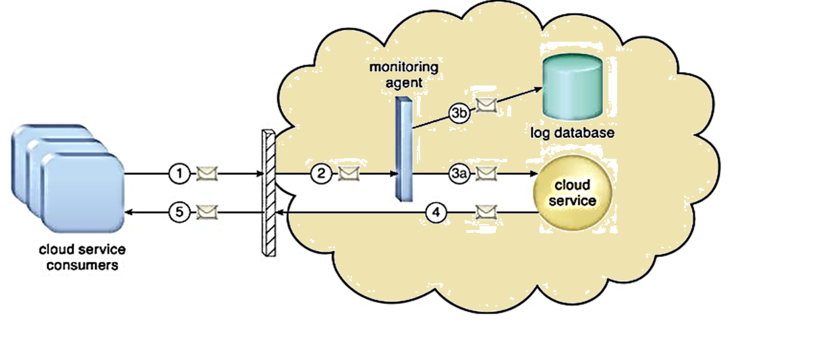
4. CLOUD USAGE MONITOR
CLOUD INFRASTRUCTURE MECHANISMS
Monitoring Agent
A monitoring agent is an intermediary, event-driven program that exists as a service agent and resides along existing communication paths to transparently monitor and analyze data flows

Slide 27
4. CLOUD USAGE MONITOR
CLOUD INFRASTRUCTURE MECHANISMS
Monitoring Agent
This type of cloud usage monitor is commonly used to measure network traffic and message metrics

Slide 28
4. CLOUD USAGE MONITOR
CLOUD INFRASTRUCTURE MECHANISMS
A cloud service consumer sends a request message to a cloud service (1)
The monitoring agent intercepts the message to collect relevant usage data (2)
before allowing it to continue to the cloud service (3a).
The monitoring agent stores the collected usage data in a log database (3b).
The cloud service replies with a response message (4)
that is sent back to the cloud service consumer without being intercepted by the monitoring agent (5)
Monitoring Agent

Slide 29
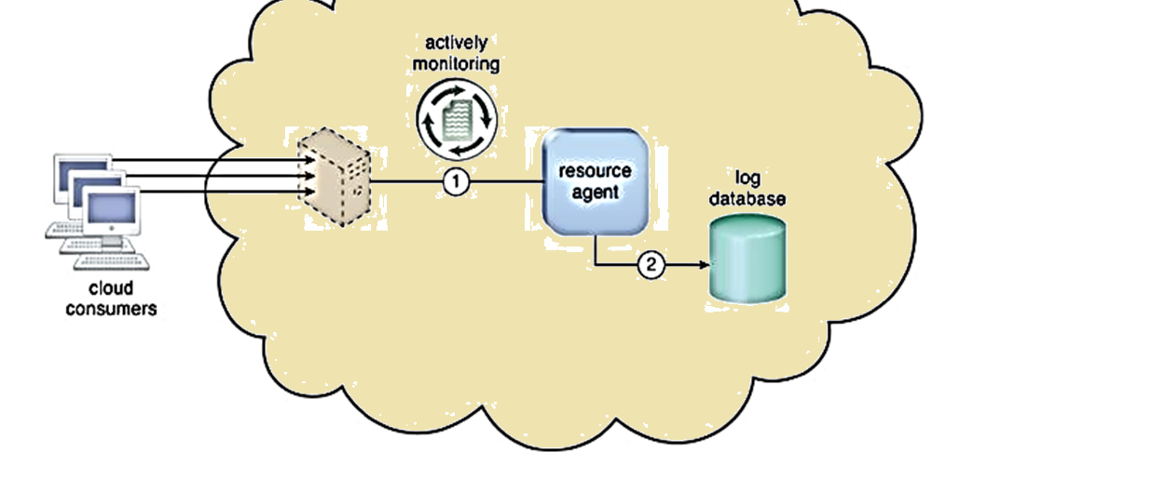
4. CLOUD USAGE MONITOR
CLOUD INFRASTRUCTURE MECHANISMS
Resource Agent
A resource agent is a processing module that collects usage data by having event-driven interactions with specialized resource software

Slide 30
4. CLOUD USAGE MONITOR
CLOUD INFRASTRUCTURE MECHANISMS
Resource Agent
This module is used to monitor usage metrics based on pre-defined, observable events at the resource software level, such as initiating, suspending, resuming, and vertical scaling

Slide 31
4. CLOUD USAGE MONITOR
CLOUD INFRASTRUCTURE MECHANISMS
The resource agent is actively monitoring a virtual server and detects an increase in usage (1)
The resource agent receives a notification from the underlying resource management program that the virtual server is being scaled up and stores the collected usage data in a log database, as per its monitoring metrics (2)
Resource Agent

Slide 32
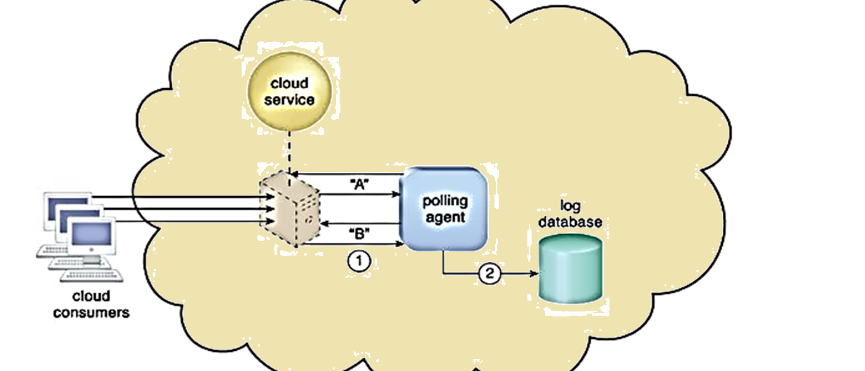
4. CLOUD USAGE MONITOR
CLOUD INFRASTRUCTURE MECHANISMS
Polling Agent
A polling agent is a processing module that collects cloud service usage data by polling IT resources.

Slide 33
4. CLOUD USAGE MONITOR
CLOUD INFRASTRUCTURE MECHANISMS
Polling Agent
This type of cloud service monitor is commonly used to periodically monitor IT resource status, such as uptime and downtime

Slide 34
4. CLOUD USAGE MONITOR
CLOUD INFRASTRUCTURE MECHANISMS
A polling agent monitors the status of a cloud service hosted by a virtual server by sending periodic polling request messages and receiving polling response messages that report usage status “A” after a number of polling cycles, until it receives a usage status of “B” (1),
upon which the polling agent records the new usage status in the log database (2).
Polling Agent

Slide 35
4. CLOUD USAGE MONITOR
CLOUD INFRASTRUCTURE MECHANISMS
The difference between resource agent and polling agent is the direction of request and response
In resource agent mechanism, the resource event is sent to the resource agent by software (eg. A Hypervisor or VIM sends info about virtual server). The agent takes a note of the event and logs it into the database
In polling agent mechanism, the polling agent polls the resource for the status change. Initially it receives the status A and while the polling continues, the status changes to B and then the polling agent records the change in status. Example Virtual machine has moved from “Pending” to “Starting” to “Started”
There is one time event notification in case of resource agent
There is continuous polling in case of polling agent

Slide 36
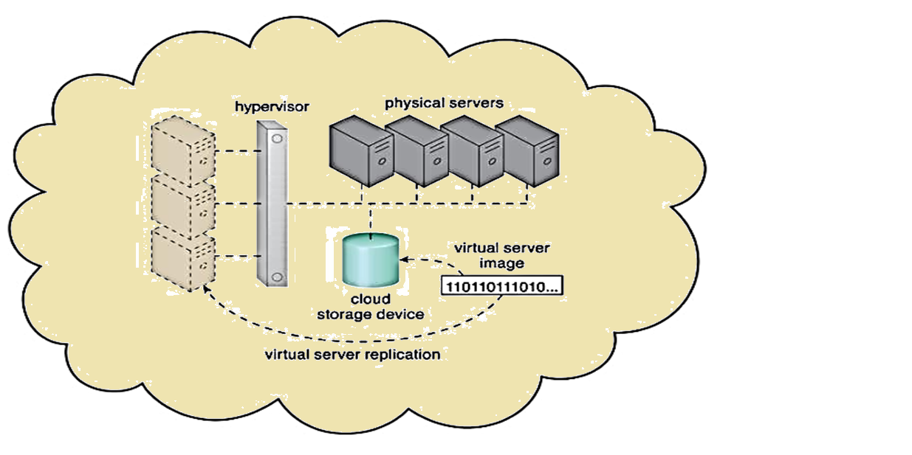
5. RESOURCE REPLICATION
CLOUD INFRASTRUCTURE MECHANISMS
Resource replication can be taught of as multiplying the existing infrastructure such as a virtual machine

Slide 37
5. RESOURCE REPLICATION
CLOUD INFRASTRUCTURE MECHANISMS
Resource replication is defined as the creation of multiple instances of the same IT resource, replication is typically performed when an IT resource’s availability and performance need to be enhanced

Slide 38
5. RESOURCE REPLICATION
CLOUD INFRASTRUCTURE MECHANISMS
The hypervisor replicates several instances of a virtual server, using a stored virtual server image
Such replication is independent of the location where the resource needs to be replicated
Such replication technique makes a resource available at any place
In case of resource failure, the resource can be replicated anywhere

Slide 39
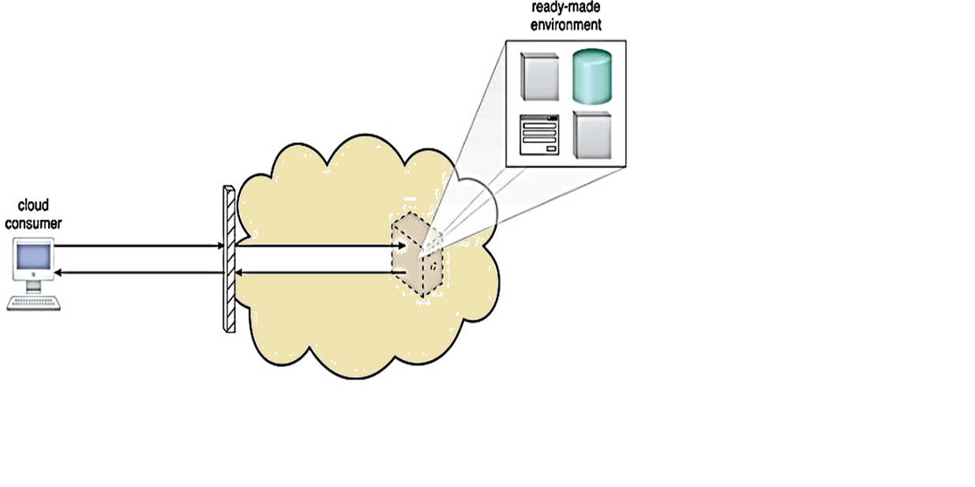
6. READY-MADE ENVIRONMENT
CLOUD INFRASTRUCTURE MECHANISMS
Ready-made environment can be thought of as some platform that is provided ready-made. It will already be installed and start with default configuration

Slide 40
6. READY-MADE ENVIRONMENT
CLOUD INFRASTRUCTURE MECHANISMS
Readymade environments can be a Java platform , a Hadoop platform , a web server like Apache and database MySQL may come pre-installed, pre-configured etc.
A cloud consumer accesses a ready-made environment hosted on a virtual server

Slide 41
6. READY-MADE ENVIRONMENT
CLOUD INFRASTRUCTURE MECHANISMS
The ready-made environment mechanism is a defining component of the PaaS cloud delivery model that represents a pre-defined, cloud-based platform comprised of a set of already installed IT resources, ready to be used and customized by a cloud consumer.
These environments are utilized by cloud consumers to remotely develop and deploy their own services and applications within a cloud.
Typical ready-made environments include pre-installed IT resources, such as databases, middleware, development tools, and governance tools
A ready-made environment is generally equipped with a complete software development kit (SDK) that provides cloud consumers with programmatic access to the development technologies that comprise their preferred programming stacks

Slide 42
thank you

